Slide 1
HOUSTONFEST 2021
A SAMPLING OF THE ART ENTRIES
(Recall that 2021 was the first “online” year due to COVID 19.)

Slide 2
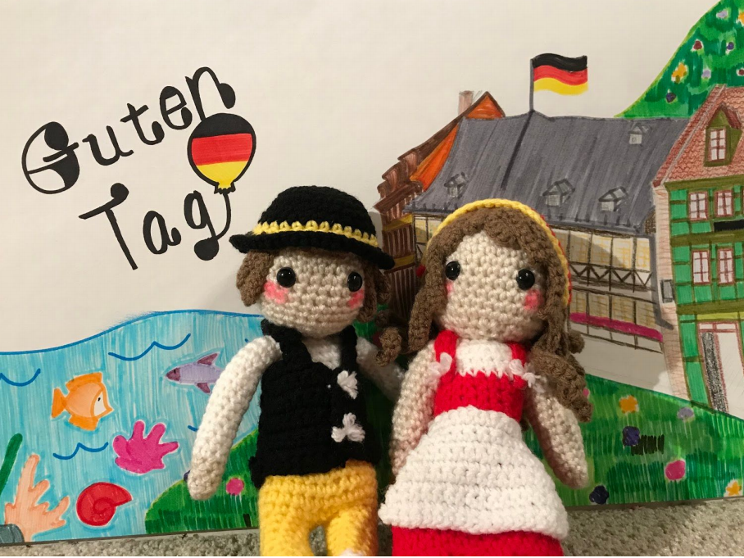
Crafts

Slide 3
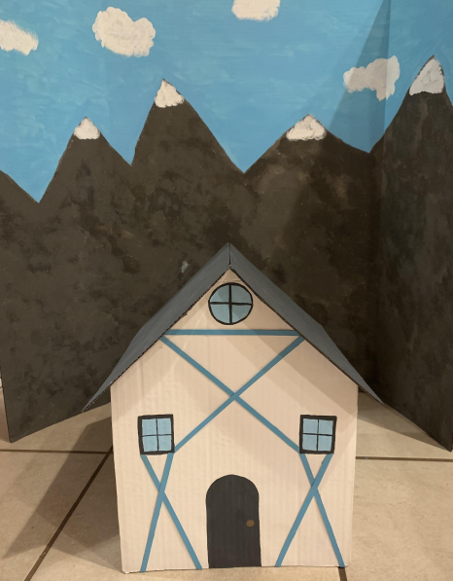
Crafts

Slide 4
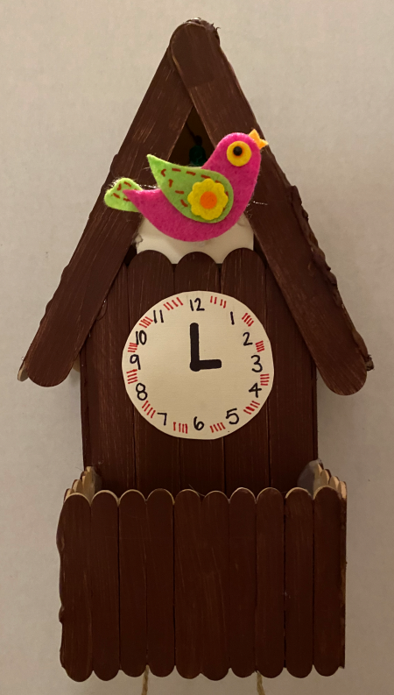
Crafts

Slide 5
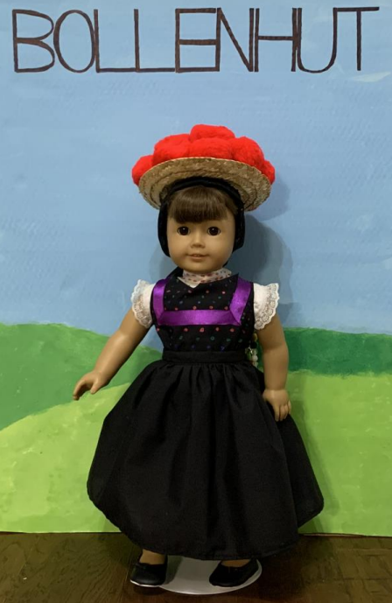
Doll Costume

Slide 6
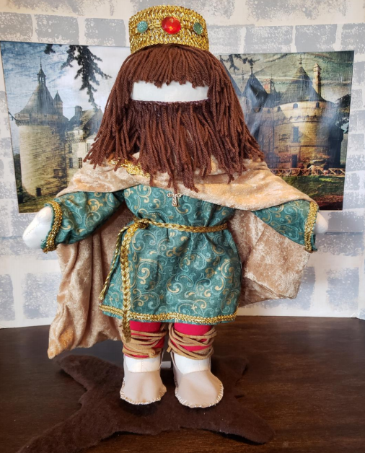
Doll Costume

Slide 7
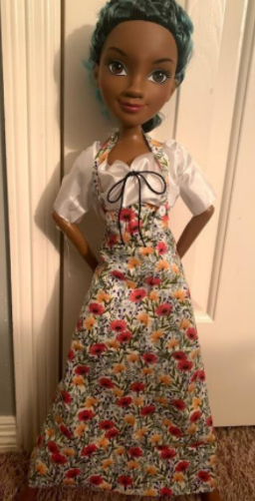
Doll Costume

Slide 8
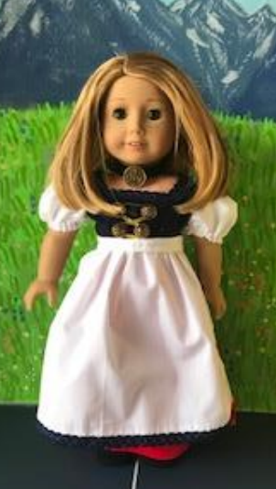
Doll Costume

Slide 9
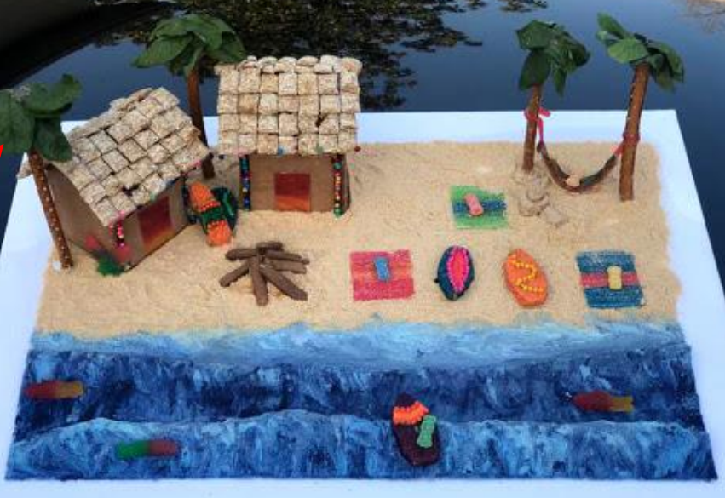
Ginger-
Bread
House
(Non-
Trad)

Slide 10
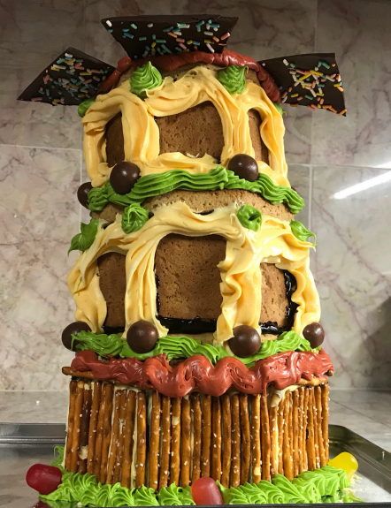
Gingerbread House –
Non-Traditional

Slide 11
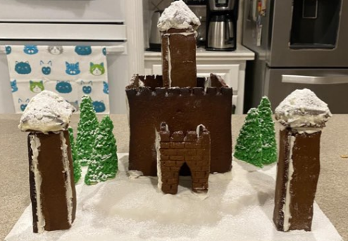
Ginger-
Bread
House
(Non-
Trad)

Slide 12
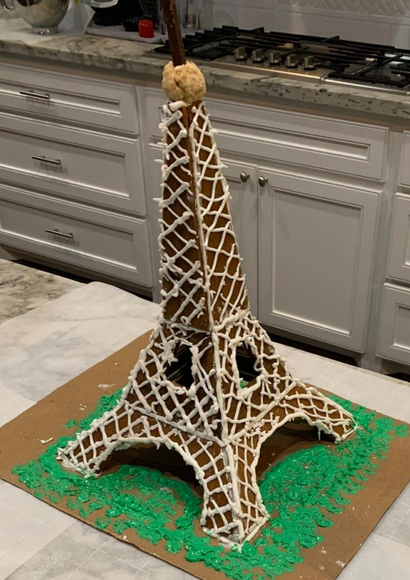
Gingerbread House –
Non-Traditional

Slide 13
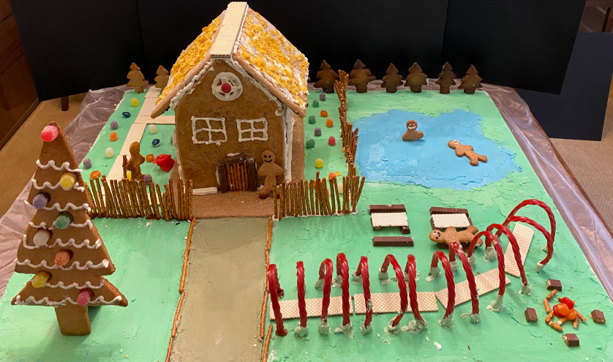
Gingerbread House –
Traditional

Slide 14
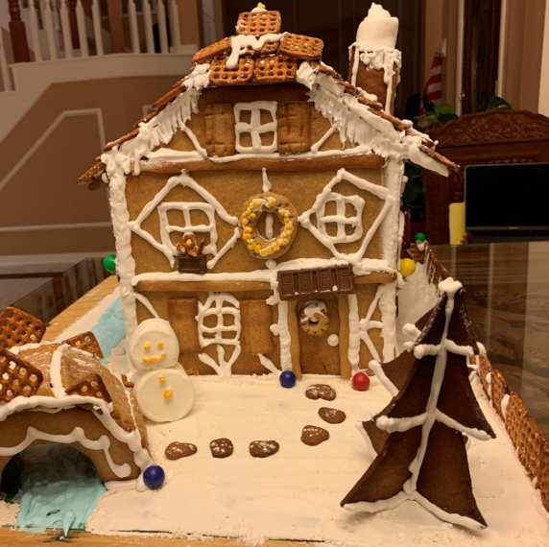
Gingerbread House –
Traditional

Slide 15
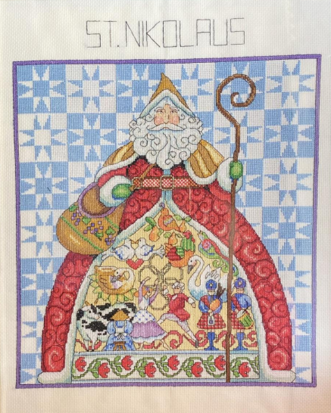
Needlework

Slide 16
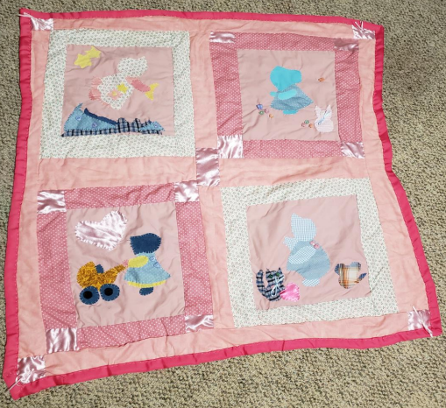
Needlework

Slide 17
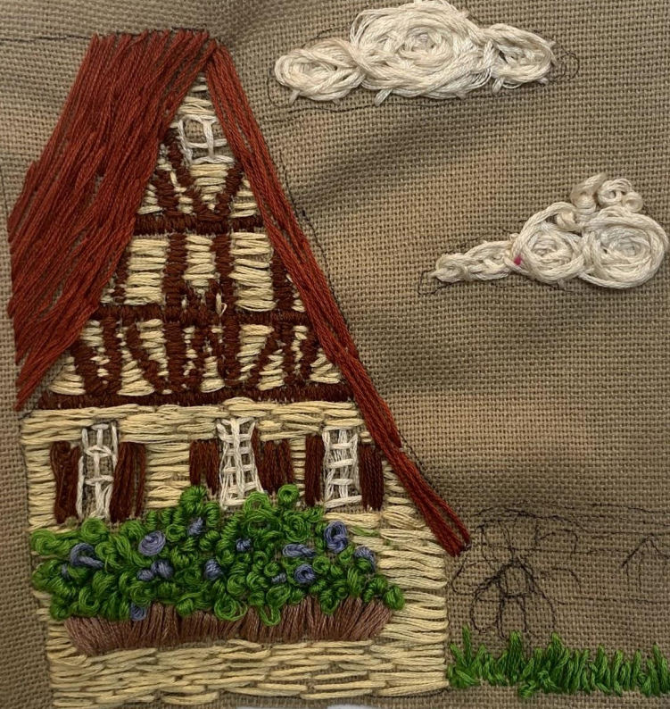
Needlework

Slide 18
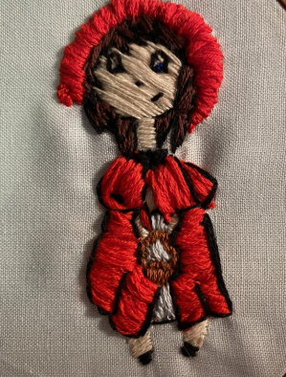
Needlework

Slide 19
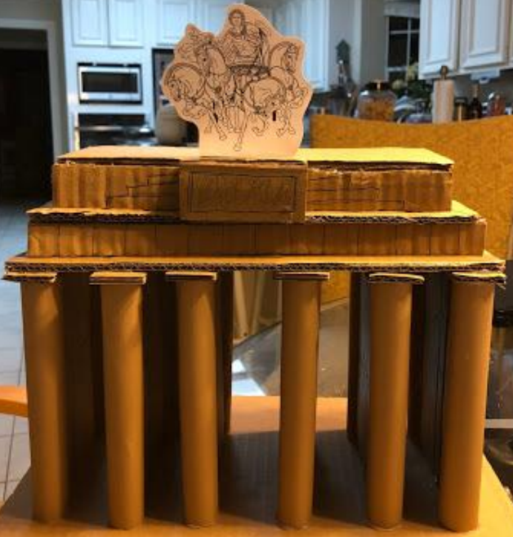
Original Model

Slide 20
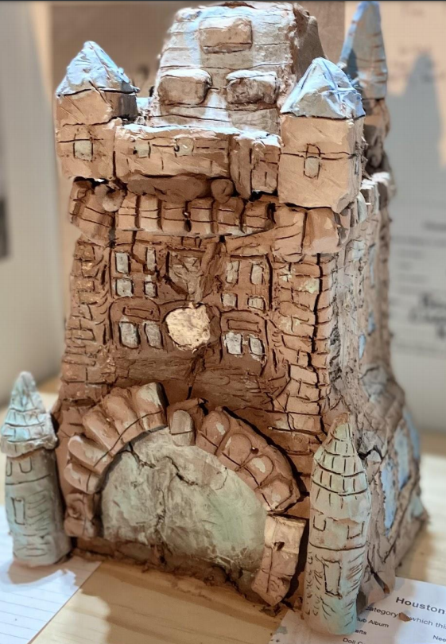
Original Model

Slide 21
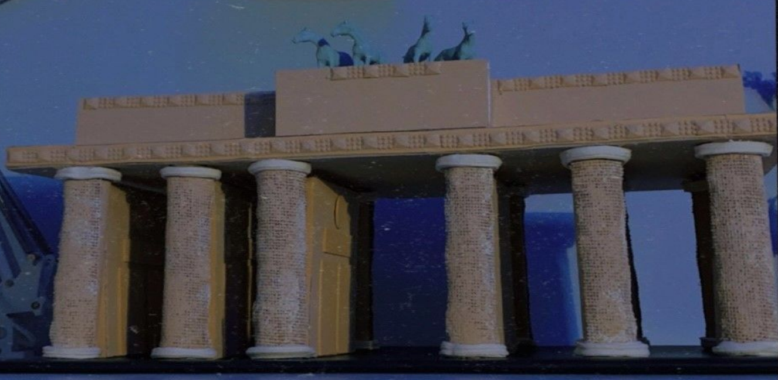
Original Model

Slide 22
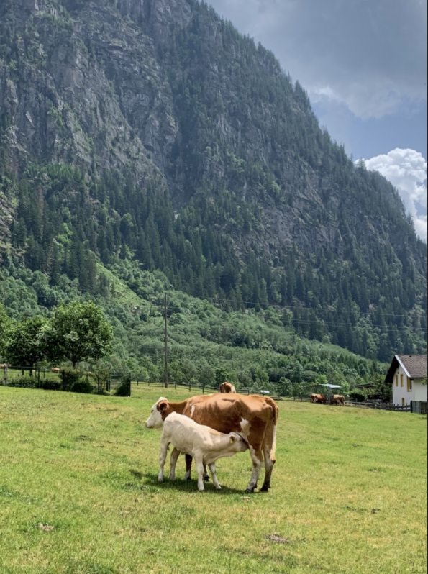
Photography

Slide 23
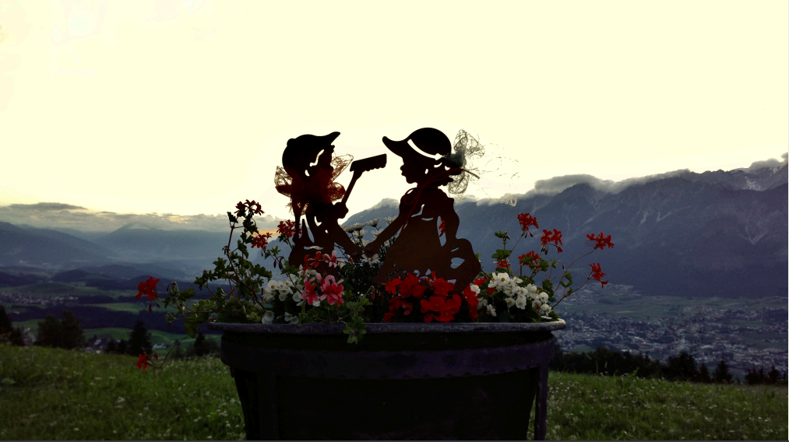
Photography

Slide 24
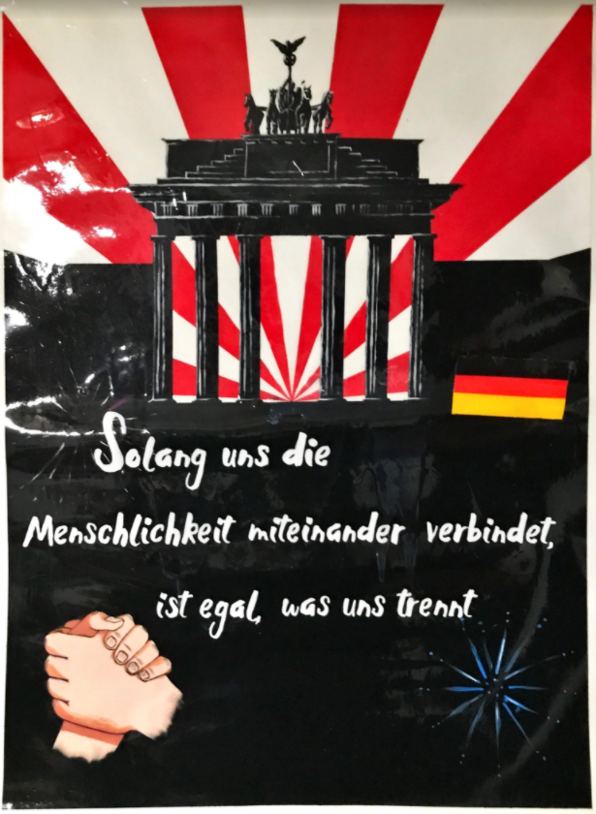
Poster

Slide 25
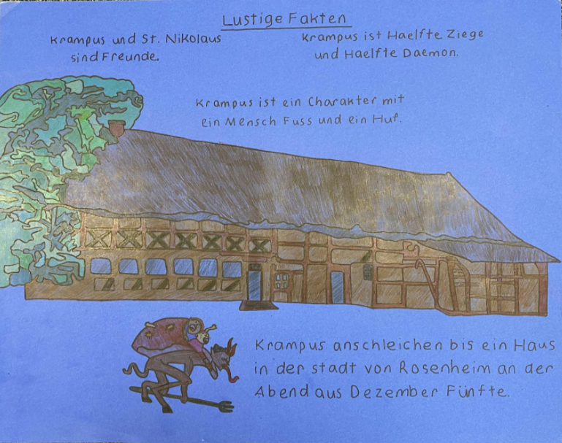
Poster

Slide 26
Poster

Slide 27
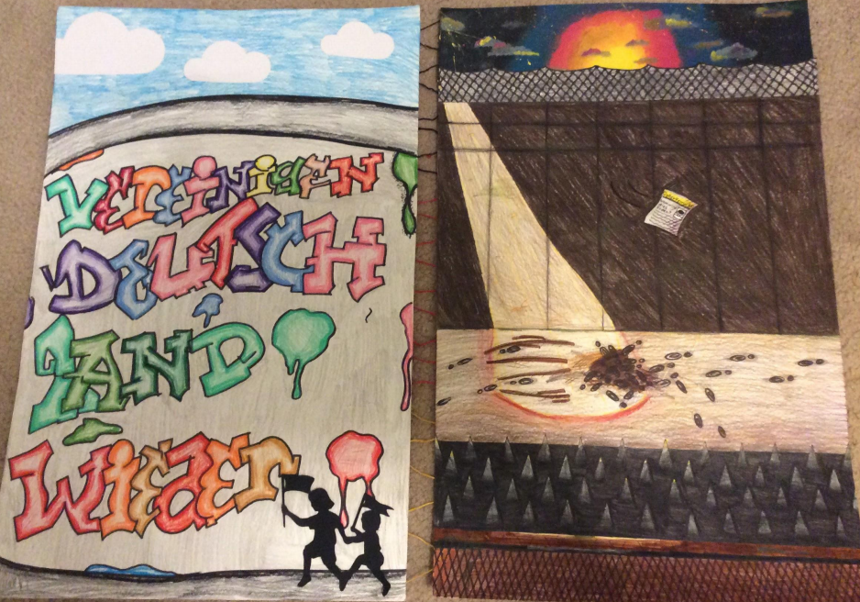
Poster

Slide 28
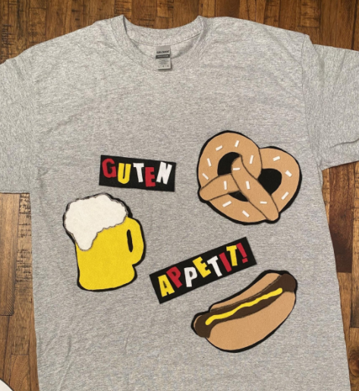
Shirt Design

Slide 29
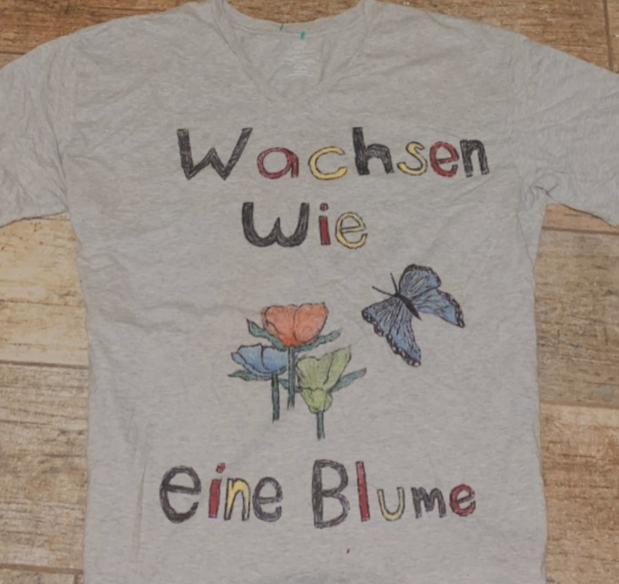
Shirt Design

Slide 30
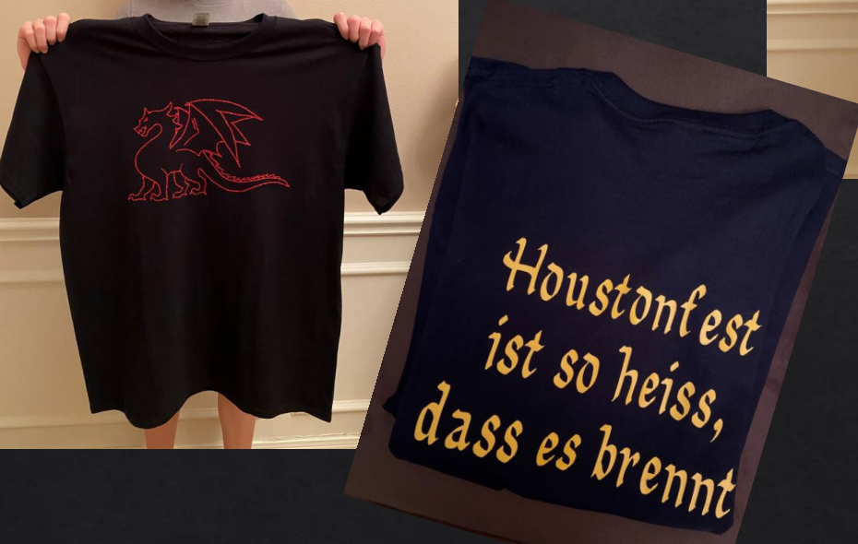
Shirt
Design

